Slide 1

Managing Midterms
The importance of finding a balance

Slide 2

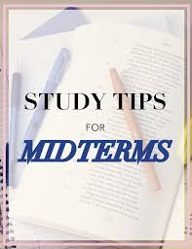
The Importance of managing midterms
-The thought of midterms can be very overwhelming.
-In college, managing midterms, projects, and finals is very important.
-Lone Star College offers many resources to help their students succeed.
-Here are some tips for managing midterms.

Slide 3

Create a Study Plan
-Time block a specific time in your day to study.
-Put away any electronics that cannot be used for studying.
-Find the perfect study location.
-Decide the order of the subjects you want to study. Remember to alternate subjects.
- You may also need to change your study plan for different subjects.

Slide 4


Don’ts
-Do not procrastinate.
-Do not wait until the night before your midterm to start studying.
-Do not pull an all-nighter; that will just make you more likely to forget what you have learned.
-Do not load up on caffeine or energy drinks. They can cause you to have more anxiety.

Slide 5


Do’s
-Eat food that helps support brain function.
-Make sure to get a good night's rest.
-Make sure to take good notes during class.
-Start preparing in advance.
-Make sure to take breaks. You will not retain the information if your brain is tired. Set a timer on your phone to watch tv, log on to social media, play a game on your phone, or go for a walk. Once the timer is up get back to studying.

Slide 6
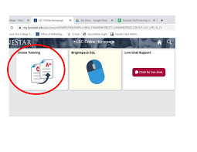
Lone Star College Resource
Tutoring Center
- https://www.lonestar.edu/tutoring.htm
- https://www.lonestar.edu/tutoring-cyfair.htm

Slide 7
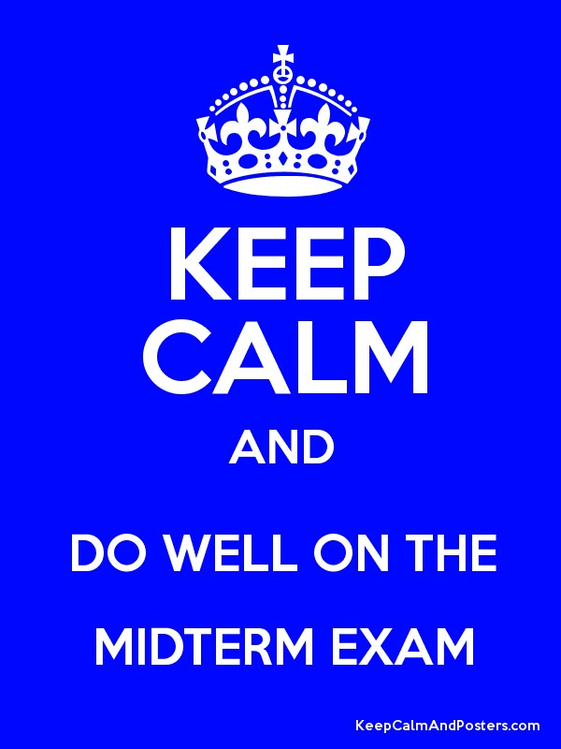
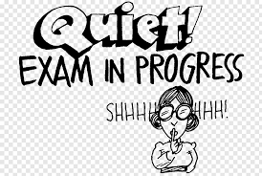
Things to Remember
-Any major tests or assignment deadlines can be very stressful.
-All of these tips can make midterm stress more manageable.
-Everyone wants to do their best on all assignments. These tips are not just for midterms.
-Try not to stress too much.

